Slide 1
Using Code::Blocks

Slide 2
What is Code::Blocks?
An Integrated Development Environment (IDE)
Project and file management
Code editing
Build (Compile + Link) and Run
Debugging support
Other IDE’s: Visual Studio, Eclipse, Xcode, NetBeans

Slide 3
Download and Install
http://www.codeblocks.org/downloads/binaries
DO NOT click on any ads on the download site!
For Windows, mingw (i.e., GNU GCC/G++ compiler and GDB debugger) is needed for this course.
Windows Installer:
codeblocks-16.01mingw-setup.exe
Casual and portable use on Windows:
codeblocks-16.01mingw-nosetup.zip
Unzip to a folder and launch, even on a USB drive!

Slide 4
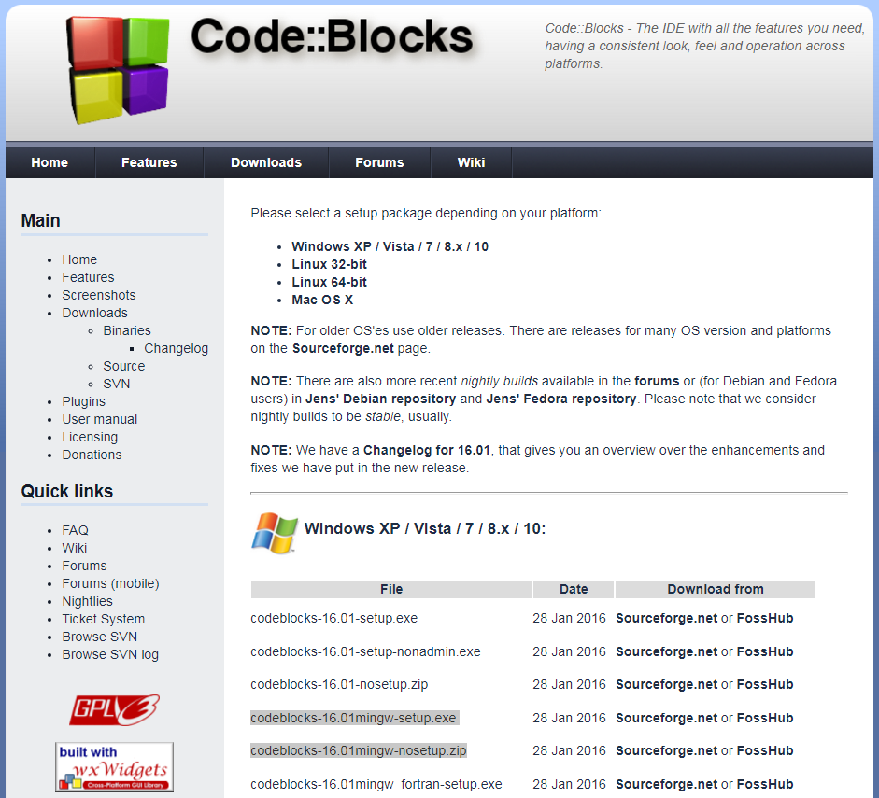

Slide 5
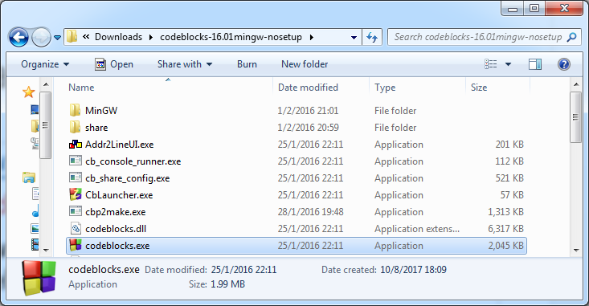
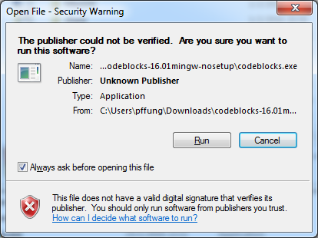

Slide 6
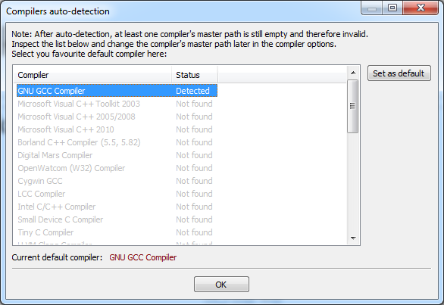
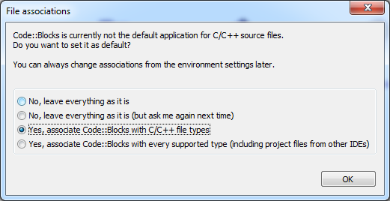

Slide 7
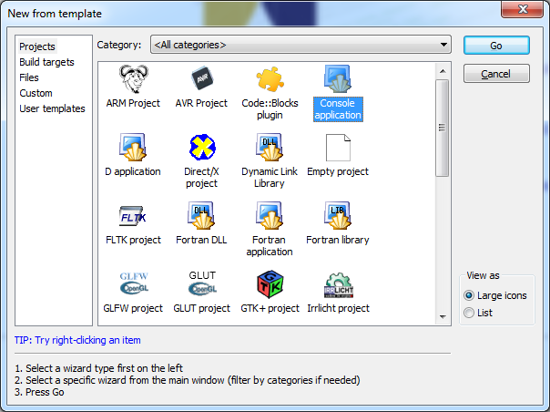
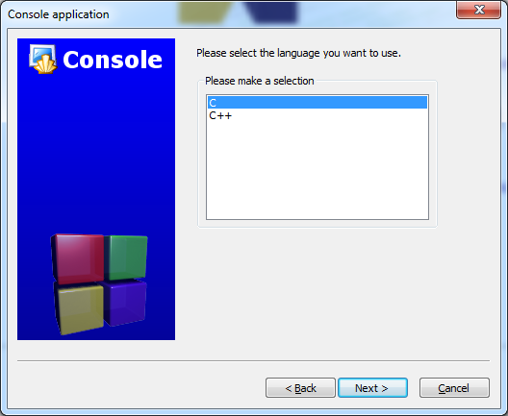

Slide 8
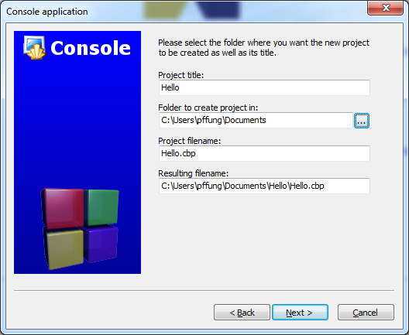
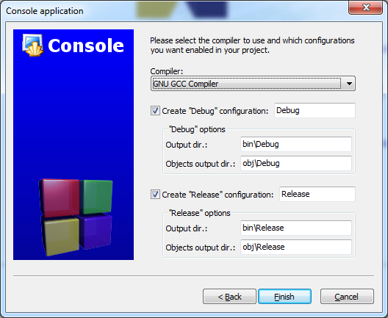

Slide 9
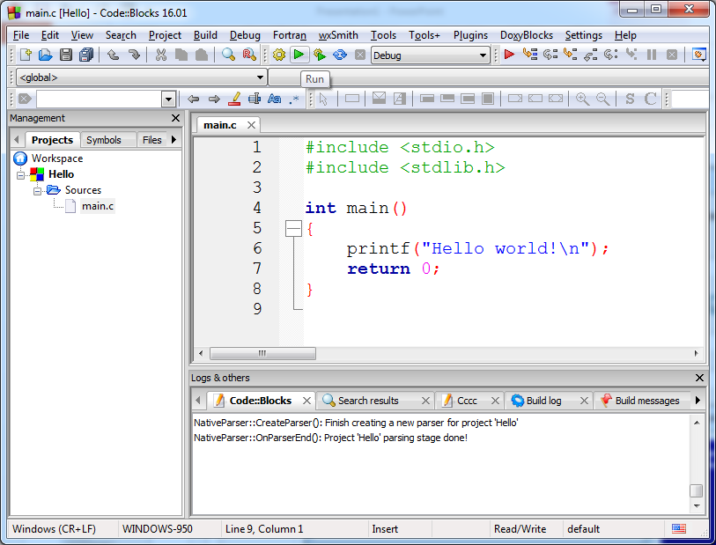
Build and run
Shortcut key: F9

Slide 10
